Slide 1
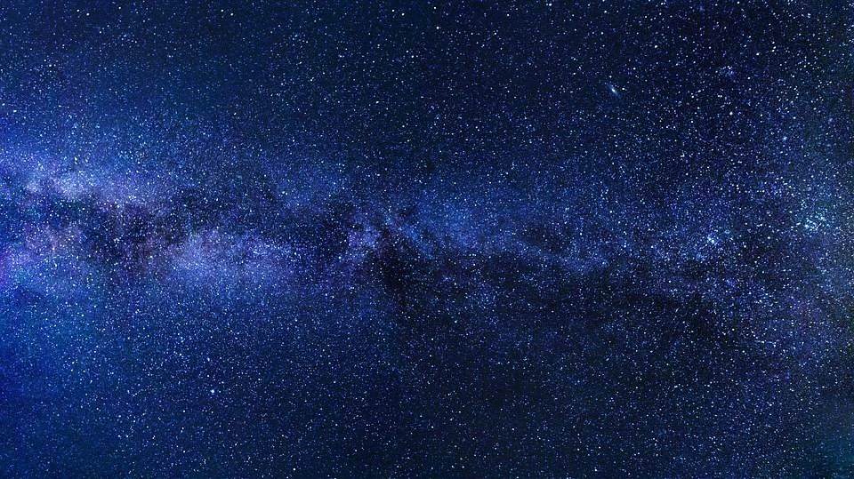
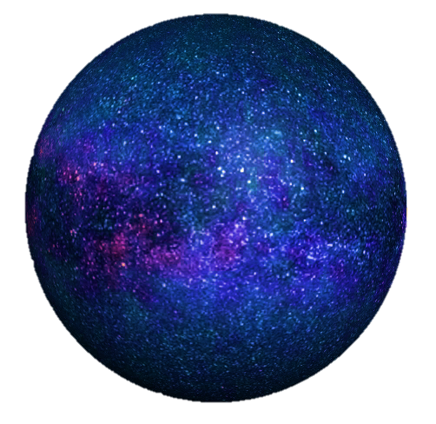
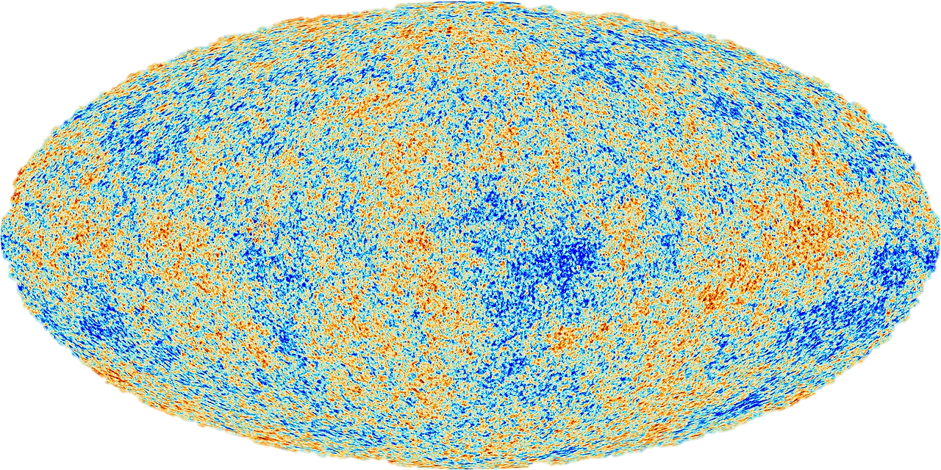
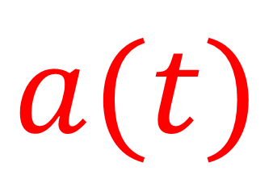




$$v=Hr$$
History of Modern Cosmology
$$Λ>0$$
$$Λ=0$$
$$Λ>0$$
1917
1929
1998
1922
1964
$$a(t)$$

Slide 2
“The universe started with the Big Bang.”
“The Universe is Expanding.”
Cosmology = origins and evolution of the universe.

Slide 3
Relativity 110: Cosmology
Sources:
Einstein’s Static Universe Model
https://arxiv.org/ftp/arxiv/papers/1701/1701.07261.pdf
1917: “Cosmological Considerations in the General Theory of Relativity” Paper
https://einsteinpapers.press.princeton.edu/vol6-trans/433
History of Cosmology
Big Bang, Expansion of the universe, Cosmological Constant, Dark Energy
Friedmann-Lemaître-Robertson-Walker (FLRW) metric
FLRW Tensors
Comoving Coordinates + FLRW Geodesics
Universe as a perfect fluid + Cosmic Rest Frame
Friedmann Equations Derivation + Interpretation

Slide 4
This video:
History of modern cosmology according to General Relativity
Why we believe in:
Big Bang, Expansion of the universe, Cosmological Constant, Dark Energy

Slide 5

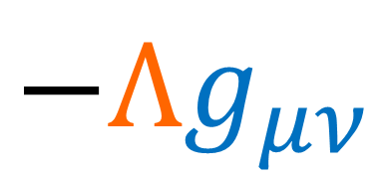

1915: Einstein publishes the field equations for general relativity
1917: Einstein publishes another paper
“Cosmological Considerations in the General Theory of Relativity”
(link in description: https://einsteinpapers.press.princeton.edu/vol6-trans/433)
$G_{μν}−Λg_{μν}=\frac{8πG}{c^{4}}T_{μν}$
$$−Λg_{μν}$$
Cosmological Constant
$\left(+−−−\right)$ metric convention

Slide 6
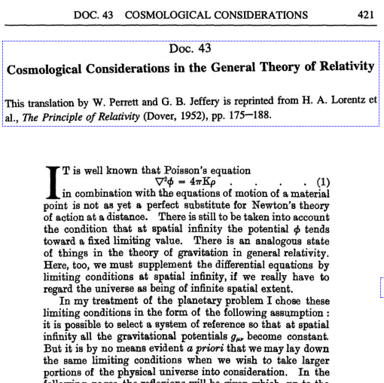

Summary: Einstein is concerned about the idea of an infinite universe full of matter.
This cases problems in General Relativity and Newtonian Gravity.
He is also concerned with making the universe “static”.
[Published in 1917 in German]
Einstein’s Solution: Add $Λ$ to his field equations.

Slide 7
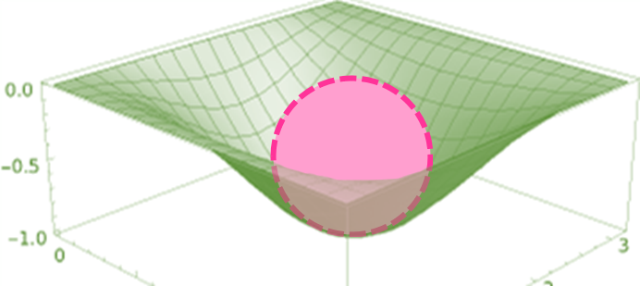

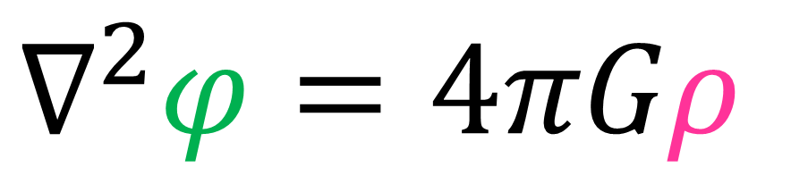
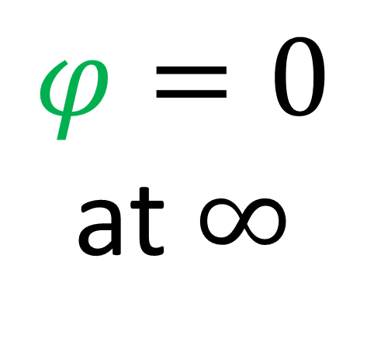




$∇^{2}φ=4πGρ$
Poisson’s Equation
Mass Density
Gravitational Potential
$$φ$$
$$m$$
$$m$$
$$ρ$$
$$m$$
$φ=0$
at $∞$

Slide 8
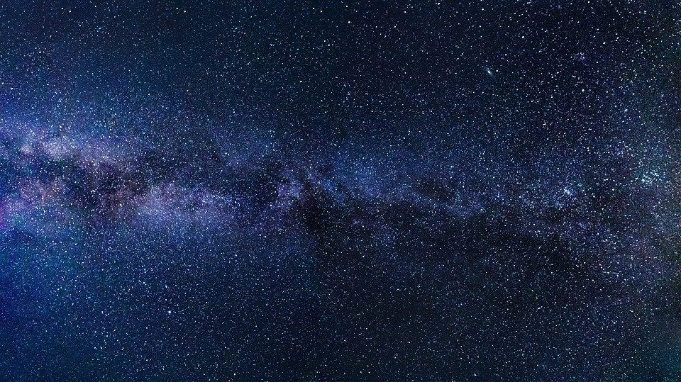

uniform mass density $ρ$
Infinite Universe

Slide 9
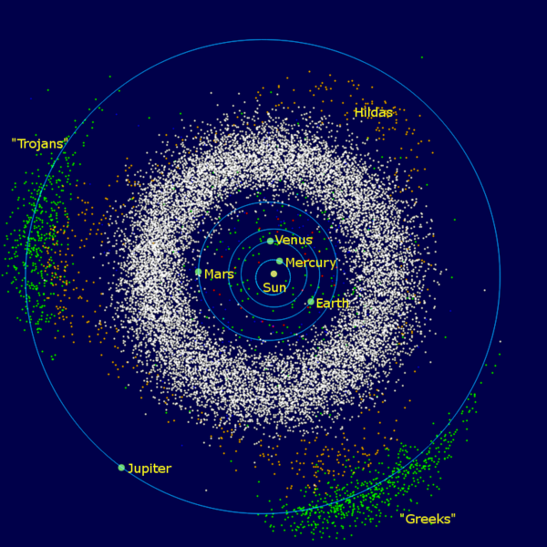
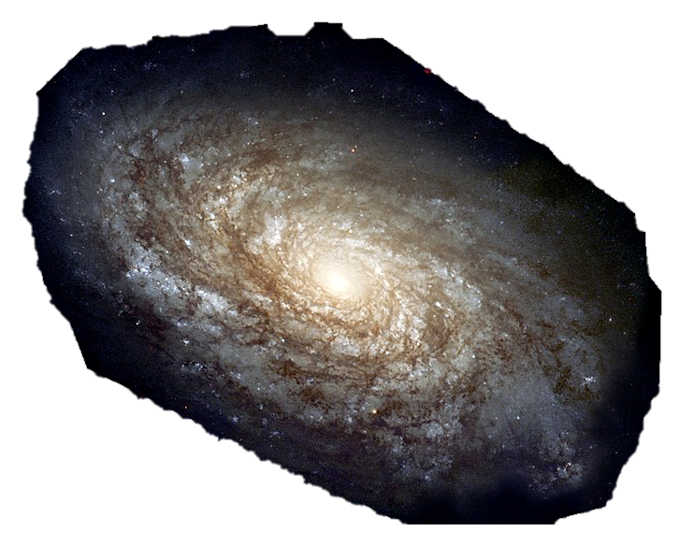
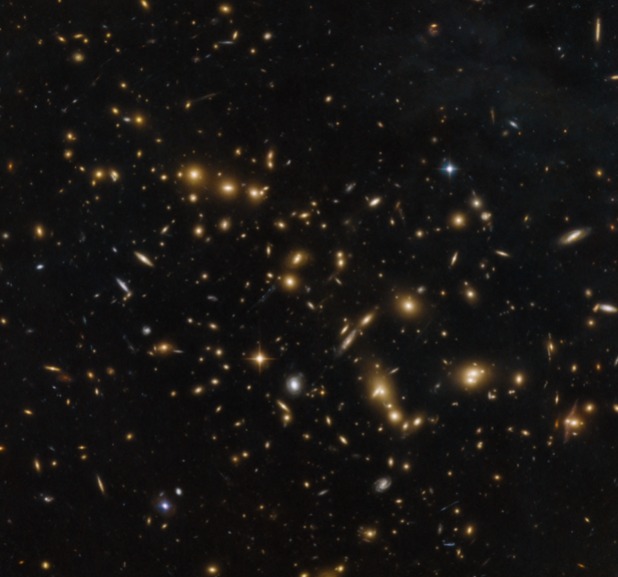
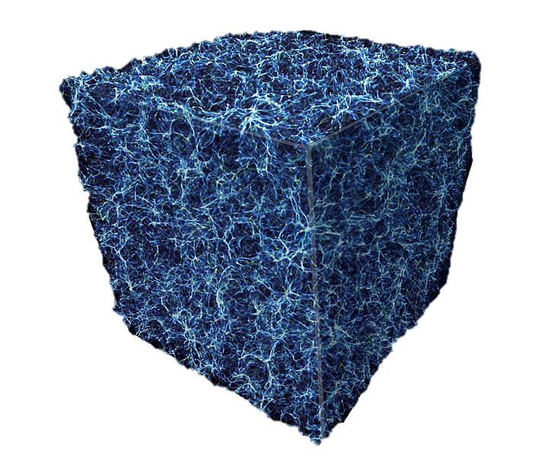
Solar System
Galaxy
Galaxy Clusters/
Superclusters
Galaxy Filaments
Zoom Out
(approximately
uniform density)

Slide 10





uniform mass density $ρ$
$φ=constant$
$∇^{2}φ=4πGρ$
$ρ=0$
Infinite Universe
“Seeliger’s Paradox”

Slide 11
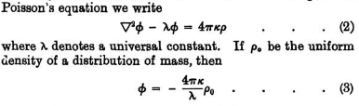
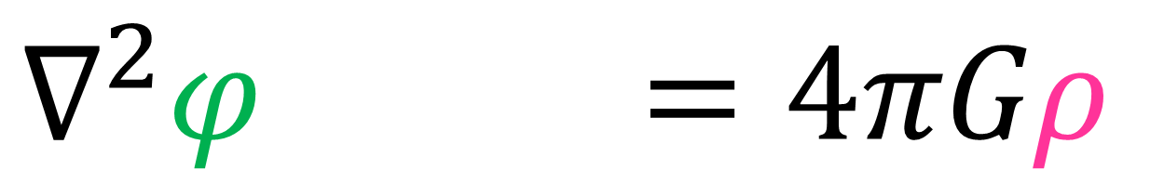


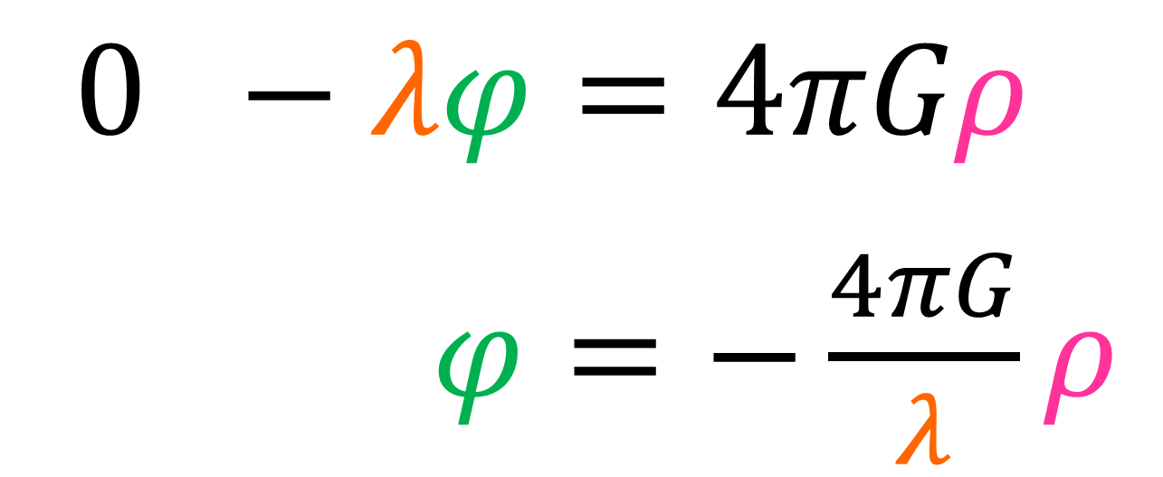

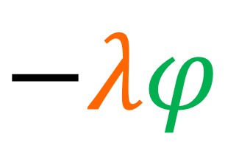
$$−λφ$$
$∇^{2}φ−λφ=4πGρ$
$φ=constant$
$0 −λφ=4πGρ$
$φ=−\frac{4πG}{λ}ρ$
$$≠0$$

Slide 12
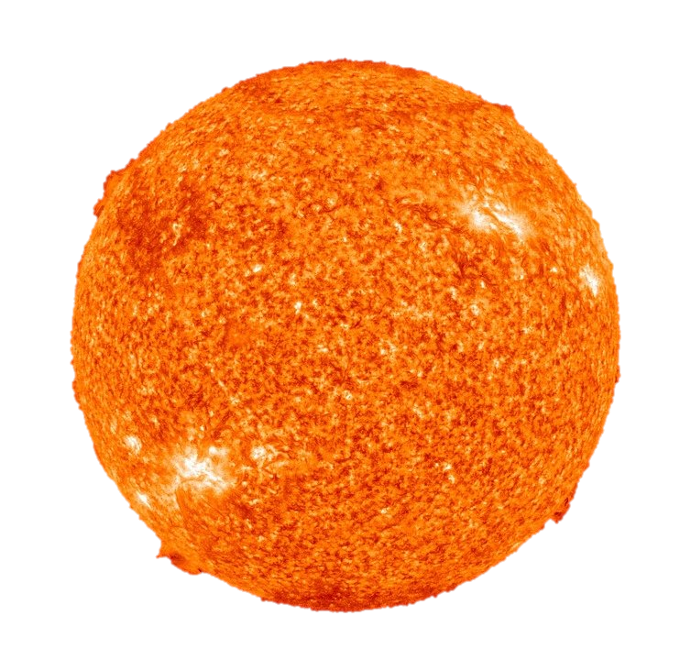
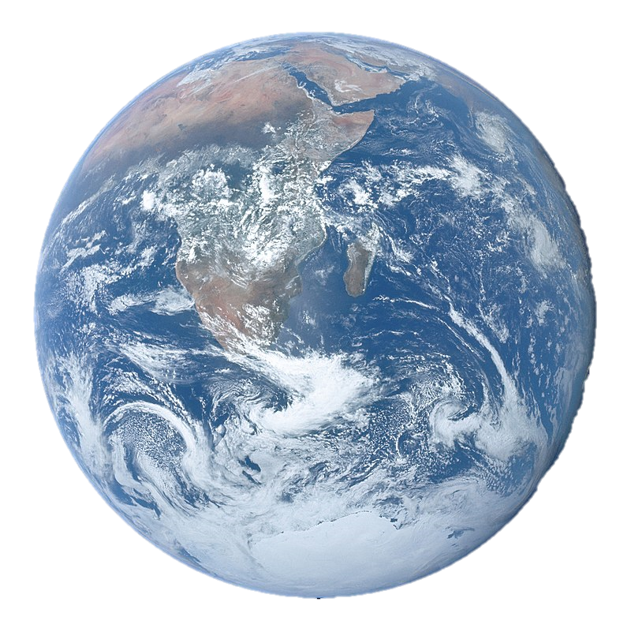

$$−λφ$$
$∇^{2}φ−λφ=4πGρ$
$φ_{avg}=−\frac{4πG}{λ}ρ_{avg}$

Slide 13
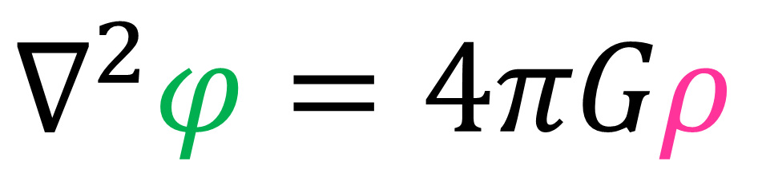

Poisson’s Equation
Newtonian Gravity
$∇^{2}φ=4πGρ$
General Relativity
$G_{μν}=\frac{8πG}{c^{4}}T_{μν}$
Einstein Field Equations

Slide 14
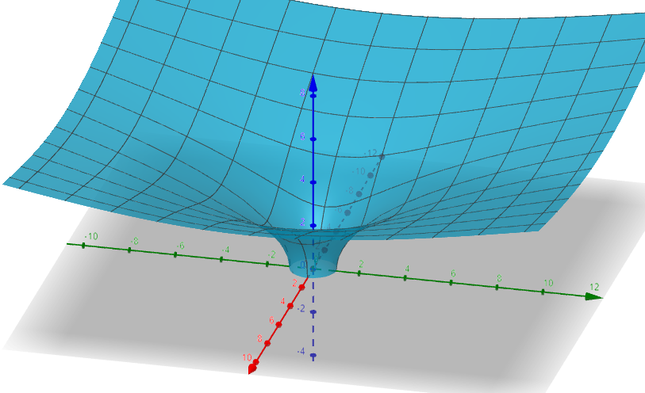
Curved Spacetime
Plotted at: https://www.geogebra.org/3d

Slide 15
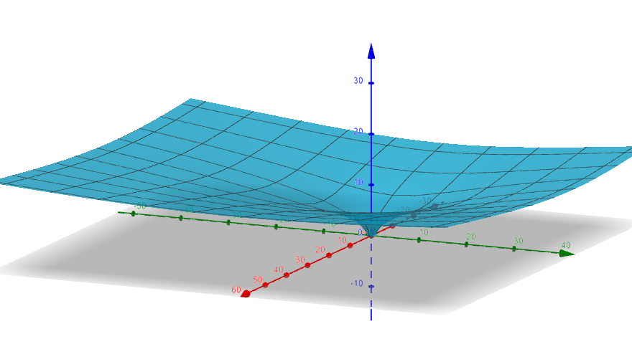
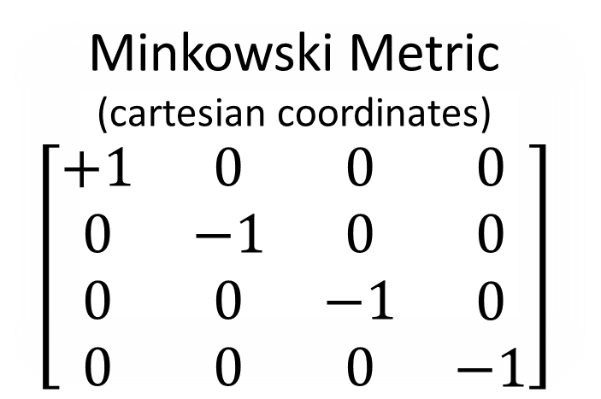

Flat Spacetime
(at infinity)
Curved Spacetime
Minkowski Metric
(cartesian coordinates)
$$\left[\begin{matrix}\begin{matrix}\begin{aligned}+1 \\ 0 \\ 0 \\ 0\end{aligned} & \begin{aligned}0 \\ −1 \\ 0 \\ 0\end{aligned}\end{matrix} & \begin{matrix}\begin{aligned}0 \\ 0 \\ −1 \\ 0\end{aligned} & \begin{aligned}0 \\ 0 \\ 0 \\ −1\end{aligned}\end{matrix}\end{matrix}\right]$$
Plotted at: https://www.geogebra.org/3d

Slide 16
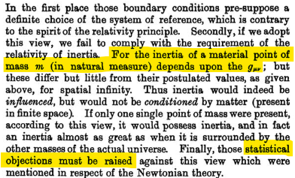
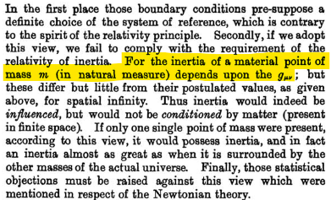
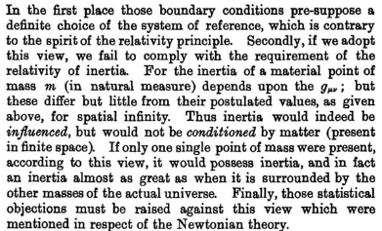

uniform mass density $ρ$
$g_{μν}$ = flat at $∞$?
Einstein has some objections
…but I don’t understand them.
Infinite Universe

Slide 17

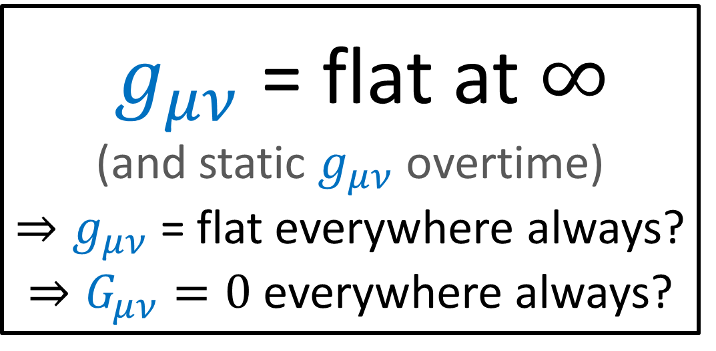


uniform mass density $ρ$
$g_{μν}$ = flat at $∞$
(and static $g_{μν}$ overtime)
$⇒g_{μν}$ = flat everywhere always?
$⇒G_{μν}=0$ everywhere always?
$G_{μν}=\frac{8πG}{c^{4}}T_{μν}$
Infinite Universe
$$T_{00}=ρc^{2}=0$$

Slide 18
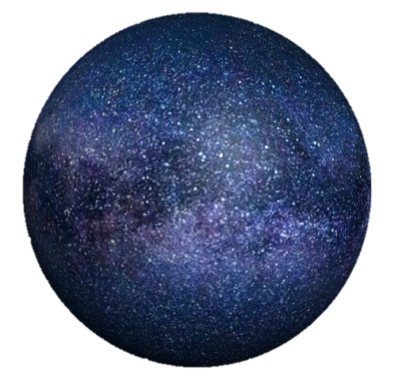

Infinite (Flat) Universe
Finite Universe
(zero curvature)
(positive curvature)

Slide 19
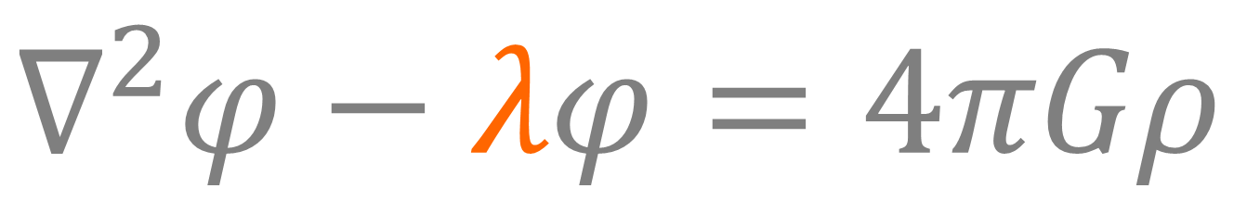
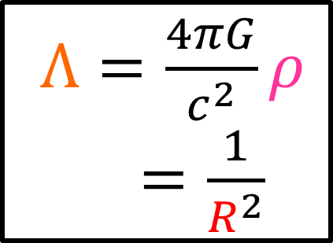
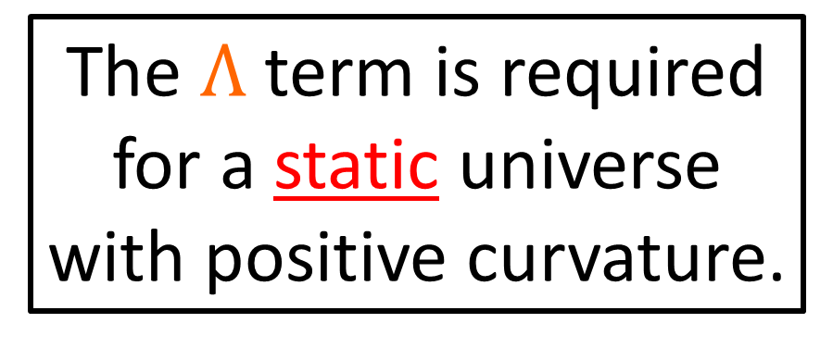
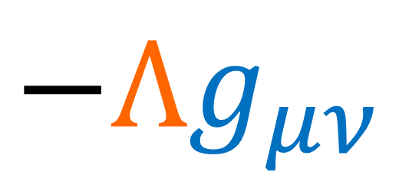

$∇^{2}φ−λφ=4πGρ$
$Λ=\frac{4πG}{c^{2}}ρ$
$Λ=\frac{1}{R^{2}}$
$G_{μν}−Λg_{μν}=\frac{8πG}{c^{4}}T_{μν}$
$$−Λg_{μν}$$
radius of universe
The $Λ$ term is required for a static universe with positive curvature.
Cosmological Constant

Slide 20
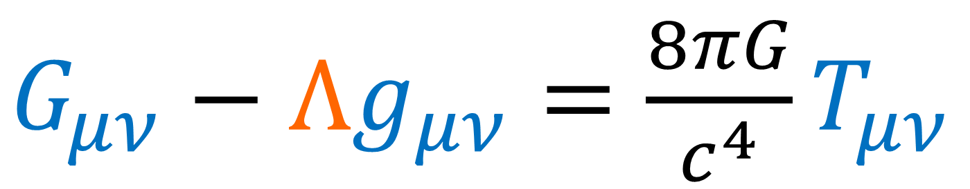

$G_{μν}−Λg_{μν}=\frac{8πG}{c^{4}}T_{μν}$
Positive curvature $k>0$

Slide 21

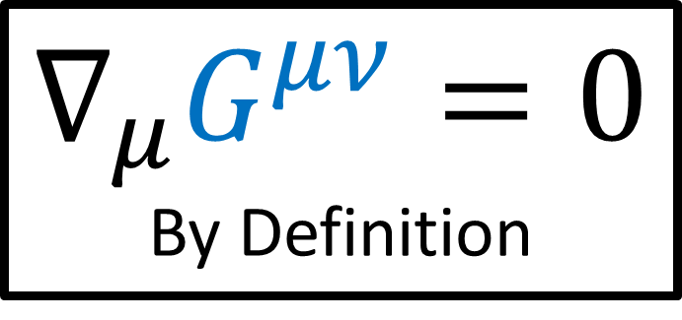
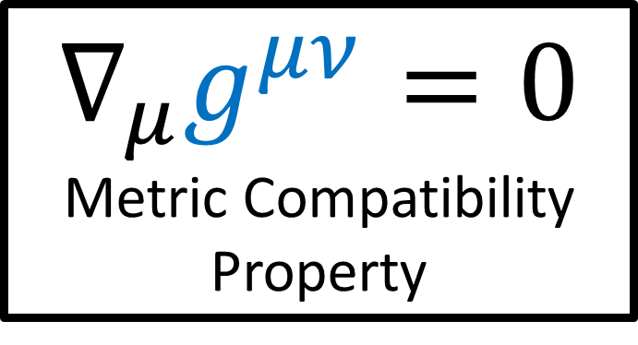
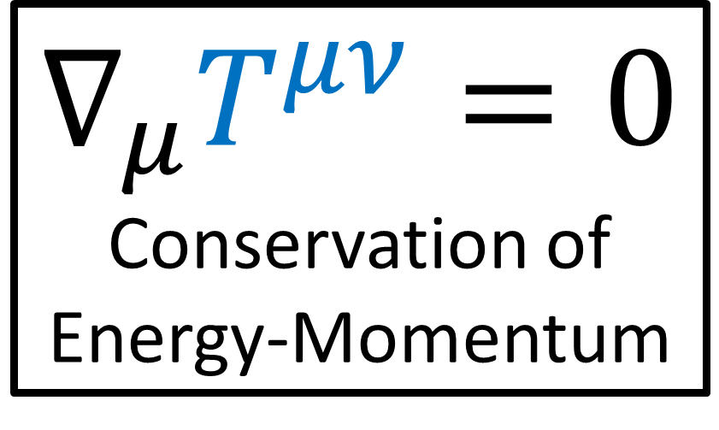
$G_{μν}−Λg_{μν}=\frac{8πG}{c^{4}}T_{μν}$
$$∇_{μ}G^{μν}=0$$
By Definition
$$∇_{μ}T^{μν}=0$$
Conservation of Energy-Momentum
$$∇_{μ}g^{μν}=0$$
Metric Compatibility Property

Slide 22
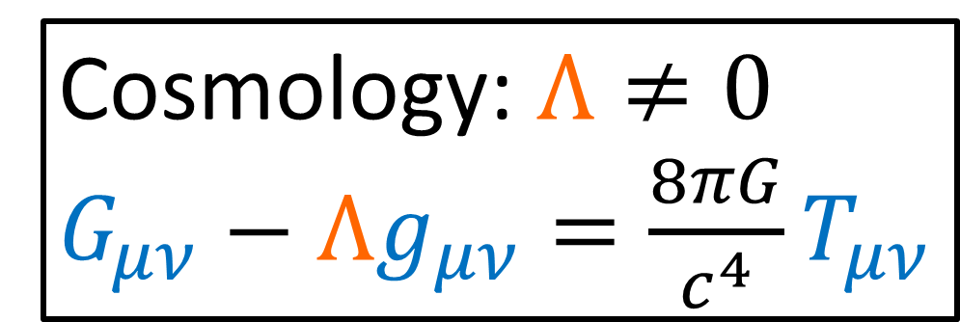

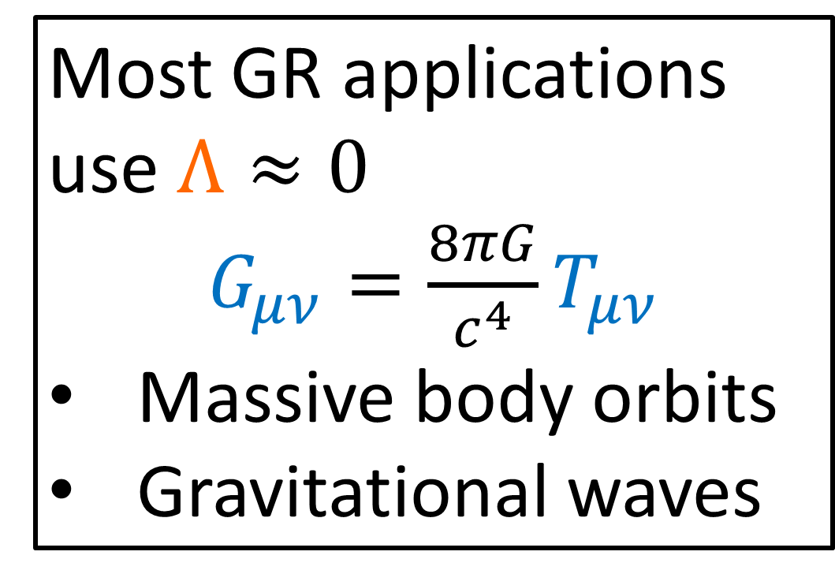
Assume $Λ≪1$
Most GR applications use $Λ≈0$
$G_{μν}=\frac{8πG}{c^{4}}T_{μν}$
Massive body orbits
Gravitational waves
Cosmology: $Λ≠0$
$G_{μν}−Λg_{μν}=\frac{8πG}{c^{4}}T_{μν}$

Slide 23
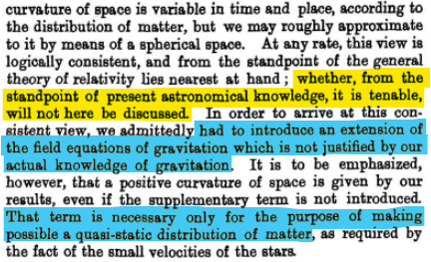
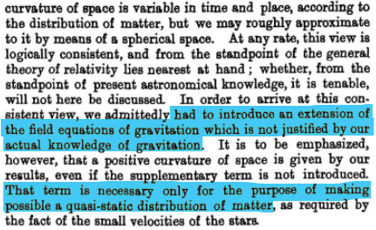
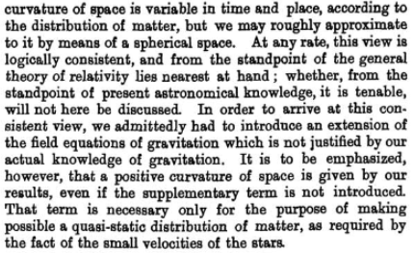
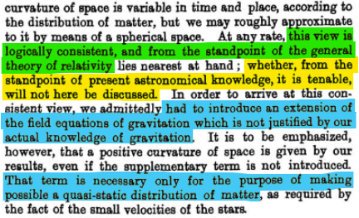
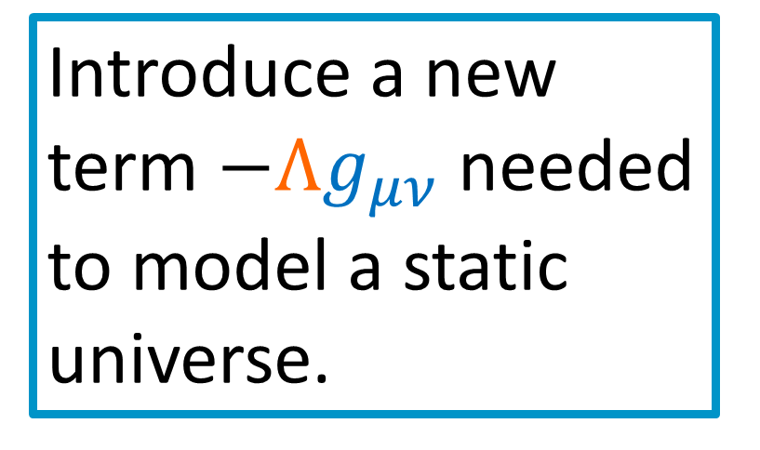
The theory lines up with General Relativity just fine.
Einstein admits he isn’t considering if this theory lines up with the latest astronomical knowledge.
Introduce a new term $−Λg_{μν}$ needed to model a static universe.

Slide 24
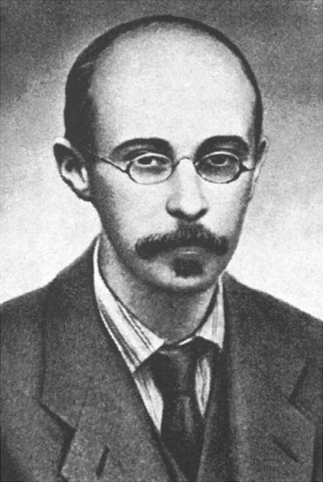
1922: Alexander Friedmann
Published the 2 Friedmann Equations
“On the Curvature of Space”, Zeitschrift für Physik (link in description)
Describe evolution of the universe overtime according to general relativity
Alexander Friedmann
(1888 – 1925)

Slide 25
(Modern) Overview of Friedmann Equations

Slide 26
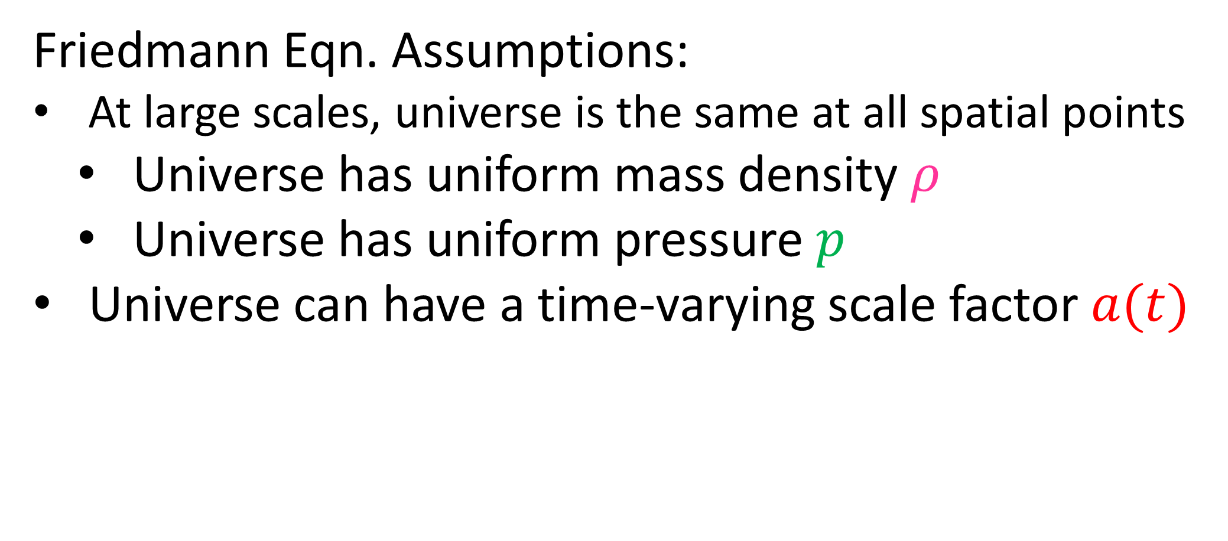
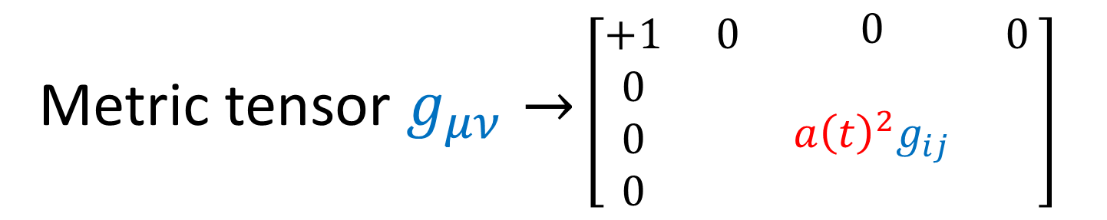
Friedmann Eqn. Assumptions:
At large scales, universe is the same at all spatial points
Universe has uniform mass density $ρ$
Universe has uniform pressure $p$
Universe can have a time-varying scale factor $a(t)$
Metric tensor $g_{μν}→$ $\left[\begin{matrix}\begin{matrix}\begin{aligned}+1 \\ 0 \\ 0 \\ 0\end{aligned} & \begin{aligned}0 \\ \\ \\ \end{aligned}\end{matrix} & \begin{matrix}\begin{aligned}0 \\ \\ a{\left(t\right)}^{2}g_{ij} \\ \end{aligned} & \begin{aligned}0 \\ \\ \\ \end{aligned}\end{matrix}\end{matrix}\right]$
All spatial points in the universe are on equal footing at large scales…
…but there was no strong evidence to suggest the universe
was the same over large scales of time.

Slide 27
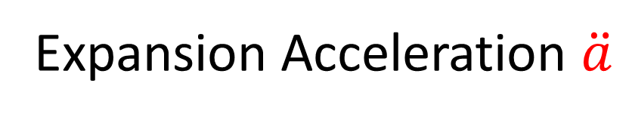
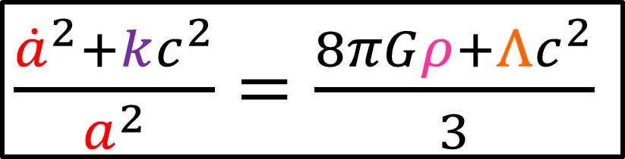
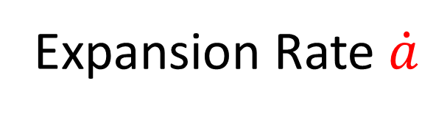




Friedmann’s Assumptions:
Universe has a time-varying scale factor $a(t)$
Universe has uniform mass density $ρ$ and pressure $p$
$G_{μν}−Λg_{μν}=\frac{8πG}{c^{4}}T_{μν}$
curvature $k$
$\frac{{\dot{a}}^{2}+kc^{2}}{a^{2}}=\frac{8πGρ+Λc^{2}}{3}$
$\frac{\ddot{a}}{a}=−\frac{4πG}{3}\left(ρ+\frac{3p}{c^{2}}\right)+\frac{Λc^{2}}{3}$
Expansion Rate $\dot{a}$
Expansion Acceleration $\ddot{a}$

Slide 28


Friedmann Equations $→$ Expanding Universe
$$a(t)$$

Slide 29

Friedmann Equations $→$ Expanding Universe
$$a(t)$$

Slide 30
Universe is like a “balloon”

Slide 31


Expansion Rate
Acceleration Rate
$$\dot{a}>0$$
$$\ddot{a}<0$$

Slide 32






Friedmann Equations, Static Solution: $\dot{a}=\ddot{a}=0$
$\frac{kc^{2}}{a^{2}}=\frac{8πGρ}{3}+\frac{Λc^{2}}{3}$
$\frac{kc^{2}}{a^{2}}=\frac{8πGρ}{3}+\frac{4πG}{3}\left(ρ+\frac{3p}{c^{2}}\right)$
$\frac{kc^{2}}{a^{2}}=\frac{12πGρ}{3}+\frac{4πG}{3}\frac{3p}{c^{2}}$
$\frac{kc^{2}}{a^{2}}=4πGρ+4πG\frac{p}{c^{2}}$
$\frac{kc^{2}}{a^{2}}=4πG\left(ρ+\frac{p}{c^{2}}\right)$
$\frac{\ddot{a}}{a}=−\frac{4πG}{3}\left(ρ+\frac{3p}{c^{2}}\right)+\frac{Λc^{2}}{3}$
$Λ=\frac{4πG}{c^{2}}\left(ρ+\frac{3p}{c^{2}}\right)$
$\frac{{\dot{a}}^{2}+kc^{2}}{a^{2}}=\frac{8πGρ+Λc^{2}}{3}$
$\frac{k}{a^{2}}=\frac{4πG}{c^{2}}\left(ρ+\frac{p}{c^{2}}\right)$

Slide 33


Source (link in description):
https://einsteinpapers.press.princeton.edu/vol13-trans/301

Slide 34

Source (link in description):
https://einsteinpapers.press.princeton.edu/vol14-trans/77

Slide 35
Actual astronomical evidence for an expanding universe:
Redshift of galaxies.

Slide 36
Doppler Effect
redshift
blueshift

Slide 37
Actual astronomical evidence for an expanding universe:
Redshift of galaxies.
Why would we expect galaxies to have any particular colour?

Slide 38




Atomic Spectroscopy
Planck Relation
nucleus
$$E=hf$$
Energy
frequency
$e^{−}$
$e^{−}$
Planck’s constant

Slide 39





Hydrogen Atom
Hydrogen Lamp
Image Source: UCL Mathematical & Physical Sciences from London, UK
Image Sources: https://en.wikipedia.org/wiki/Hydrogen_spectral_series
$←$ Balmer Series

Slide 40

(spectral lines on visible spectrum are highlighted)
Spectral lines act as a “fingerprint” for a given element.
Source: https://en.wikipedia.org/wiki/Spectral_line#Visible_light

Slide 41



Atomic Spectroscopy
Planck Relation
nucleus
$$E=hf$$
Energy
frequency
$e^{−}$
$e^{−}$
Planck’s constant

Slide 42

https://en.wikipedia.org/wiki/Astronomical_spectroscopy#Stars_and_their_properties

Slide 43
White light
(full spectrum)
Hydrogen Gas
Hydrogen Absorption Spectrum

Slide 44









$$Na$$
$$N$$
$$He$$
$$C$$
$$O$$
$$H$$
$$Ca$$
$$Mg$$
Sun absorption spectrum (a.k.a. “Fraunhofer lines”)
Source: https://en.wikipedia.org/wiki/Fraunhofer_lines

Slide 45

sdfsdf
Light from stars/galaxies will be missing specific frequencies due to absorption by elements present in atmospheres / gases.

Slide 46
Standard
Hydrogen Absorption Spectrum
Blueshift
Redshift

Slide 47

1912: Vesto Slifur
First observed light from distant galaxies was redshifted
Before Einstein completed General Relativity (1915)
Vesto Slifur
(1875 – 1969)

Slide 48

1927: Georges Lemaître
Built on Einstein’s paper, and observation of galaxy redshift
Proposed the universe was expanding
Universe had constant positive curvature
Universe’s radius would increase without bound overtime
Georges Lemaître (1894 – 1966)

Slide 50
NOT the center of the universe!

Slide 52
All spatial points are equivalent!
The universe has no center!!

Slide 54


Source (link in description): https://academic.oup.com/mnras/article/91/5/483/985165
1927: Georges Lemaître
“A homogeneous universe of constant mass and increasing radius accounting for the radial velocity of extra-galactic nebulae”
Universe can have constant positive curvature
Proposed the universe was expanding
Radial velocity $v$
proportional to radius from earth $r$
(Hubble’s Law)

Slide 55

Georges Lemaître
In the distant past, the universe expanded from a single point
Called “The Primeval Atom”
Same idea as “The Big Bang Theory”

Slide 56




1929: Edwin Hubble
Studied redshift of distance galaxies
Proposed linear relationship between galaxy’s
radius from earth $r$,
and its radial velocity $v$
$$v=Hr$$
Hubble’s Law
(Hubble-Lemaître Law)
Edwin Hubble (1889 – 1953)
$H(t)$ Hubble Parameter

Slide 57





1929: Edwin Hubble
$=\frac{\dot{a}}{a}$
$\frac{v}{r}=H=\frac{\dot{a}}{a}$
from universe scale factor $a(t)$
Hubble Parameter
Original present-time Estimate:
$H≈500 km/s per MPc$
MPc = MegaParsec
= 3.26 million lightyears
Current present-time Estimate:
$H≈70 km/s per MPc$
Edwin Hubble (1889 – 1953)

Slide 58


1929: Edwin Hubble
Einstein, after learning of Hubble’s work, abandoned the cosmological constant.
$$Λ=0$$
George Gamow reported that:
Einstein said $Λ$ was his “biggest blunder”.
Edwin Hubble (1889 – 1953)

Slide 59

Cosmic Microwave Background (CMB) Radiation
Low-energy electro-magnetic radiation left over from the early universe
Exists everywhere in space
Travels in all directions
CMB as seen from the Planck satellite.
Credit: European Space Agency (ESA)
https://www.esa.int/ESA_Multimedia/Images/2013/03/Planck_CMB

Slide 60


1948: Ralph Alpher (and supervisor Robert Herman)
Published a paper on the formation of heavy elements in the early universe
Ralph Alpher
(1921-2007)

Slide 61








Matter-Dominated Early Universe
$p^{+}$
$e^{−}$
$e^{−}$
$n^{0}$
$p^{+}$
$p^{+}$
$n^{0}$
$e^{−}$

Slide 62








Matter-Dominated Early Universe
$p^{+}$
$e^{−}$
$e^{−}$
$n^{0}$
$p^{+}$
$p^{+}$
$n^{0}$
$e^{−}$
(Heavy atoms form early on)
(Heavier atoms can be made by nuclear fusion inside stars, or via “neutron capture”)

Slide 63




Radiation-Dominated Early Universe
$p^{+}$
$e^{−}$
$e^{−}$
$p^{+}$

Slide 64
Radiation-Dominated Early Universe
$p^{+}$
$e^{−}$
$e^{−}$
$p^{+}$

Slide 65
Radiation-Dominated Early Universe
$p^{+}$
$e^{−}$
$e^{−}$
$p^{+}$

Slide 66


Radiation-Dominated Early Universe
$p^{+}$
$e^{−}$
$e^{−}$
(Atoms are prevented from forming early on)
$p^{+}$

Slide 67

Cosmological Redshift
Blue Light (higher energy)

Slide 68

Cosmological Redshift
Blue Light (higher energy)
Red Light (lower energy)
$⇒$ Universe is cooling overtime

Slide 69




Universe after radiation has “cooled”
$e^{−}$
$p^{+}$
$e^{−}$
$p^{+}$

Slide 70


Universe after radiation has “cooled”
“Recombination”
($\sim$370,000 years after Big Bang) Phase in universe’s history when radiation has cooled enough to allow atoms to form.
$p^{+}$
$e^{−}$
$e^{−}$
$p^{+}$

Slide 71
If the Big Bang Theory is correct…
Early-universe radiation should still be around today
Will have a much larger wavelength / lower frequency due to the expansion of the universe
CMB radiation is NOT predicted for an eternal, steady-state universe

Slide 72
Radiation-Dominated Early Universe
$p^{+}$
$e^{−}$
$e^{−}$
$p^{+}$

Slide 73
$p^{+}$
$e^{−}$
$e^{−}$
$p^{+}$

Slide 74




1964: CMB Detected
Holmdel Horn Antennta
When aimed at empty space, detects a near-uniform noise signal
Frequency distribution matched a black body of 2.725K
2.725K
Left: Arno Allan Penzias (1933-Present)
Right:Robert Woodrow Wilson (1936-Present)

Slide 75





Motion
$$\sim 368 km/s$$
Relative to CMB
$$−3.36 mK$$
(redshift)
$$+3.36 mK$$
(blueshift)
CMB dipole image source:
https://asd.gsfc.nasa.gov/archive/mather/cobe/science.html

Slide 76
2.72548 ± 0.00057 K
Subtract dipole + radiation from stars
(Image acquired by Planck Spacecraft in 2009-2013)

Slide 77
Cosmic Microwave Background (CMB) Radiation
Strong evidence of The Big Bang Theory
CMB as seen from the Planck satellite.
Credit: European Space Agency (ESA)
https://www.esa.int/ESA_Multimedia/Images/2013/03/Planck_CMB

Slide 78
Cosmic Microwave Background
Galactic Redshift
1970s: Big Bang Theory reaches widespread acceptance as the main theory of cosmology.

Slide 79



Discovery that $Λ$ may be non-zero.
Not long after Hubble’s publication on galaxy redshift (1929)…
It was generally assumed that $Λ=0$
In the 1990s, evidence was collected that shows the universe’s expansion is accelerating…
Simplest explanation: $Λ>0$

Slide 80

1998: two independent groups observed supernova from galaxies at different distances from earth
Type 1a supernova
Light from farther away is light from earlier in the universe’s history.
Conclusion: speeds of various galaxies travelling away
from the Milky Way is INCREASING overtime!

Slide 81





Universe expansion is accelerating: $\ddot{a}>0$
Friedmann Equations #2 says:
$\frac{\ddot{a}}{a}=−\frac{4πG}{3}\left(ρ+\frac{3p}{c^{2}}\right)+\frac{Λc^{2}}{3}$
$$>0$$
$$<0$$
$$>0$$

Slide 82

Cosmological Constant $Λ$
“Dark Energy”

Slide 83



Standard Form
$R_{μν}−\frac{1}{2}Rg_{μν}−Λg_{μν}=\frac{8πG}{c^{4}}T_{μν}$
$R_{μν}=\frac{8πG}{c^{4}}\left(T_{μν}−\frac{1}{2}Tg_{μν}\right)−Λg_{μν}$
$R_{μν}=\frac{8πG}{c^{4}}\left(T_{μν}−\frac{1}{2}\left(T+\frac{c^{4}}{4πG}Λ\right)g_{μν}\right)$
Trace-Reversed Form
A form of energy?
“Dark Energy”

Slide 84


Cosmological Constant $Λ$
Possible explanations for universe’s accelerating expansion
“Quintessence” Time-Varying Scalar Field
“Dark Energy”
…

Slide 85

1917: Einstein introduces $Λ$ to ensure his spherical finite universe is static (not expanding/contracting)
1922: Friedmann derives 2 equations which show the universe’s spatial scale $a(t)$ can change overtime
1927/1929: Lemaître + Hubble observe redshift of distant galaxies, which was good evidence that the universe was expanding
1964: Discovery of the CMB gives good evidence for the Big Bang
1998: Expansion of the universe is accelerating, $Λ>0$

Slide 86
Next Videos:
Math of FLRW Metric
Derive Friedmann Equations

